Slide 1
ALL STATIONS SEASONAL AVG MAX TEMP ANALYSIS
Observations from 6 Stations

Slide 2
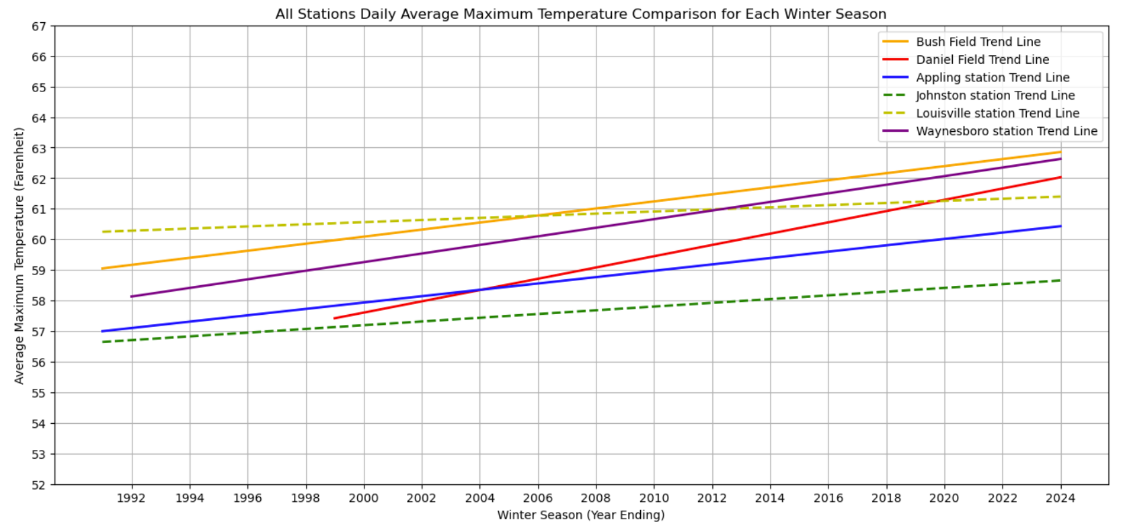
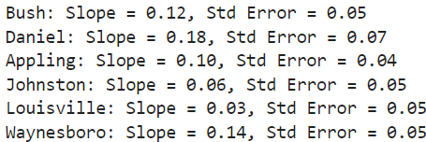

Slide 3

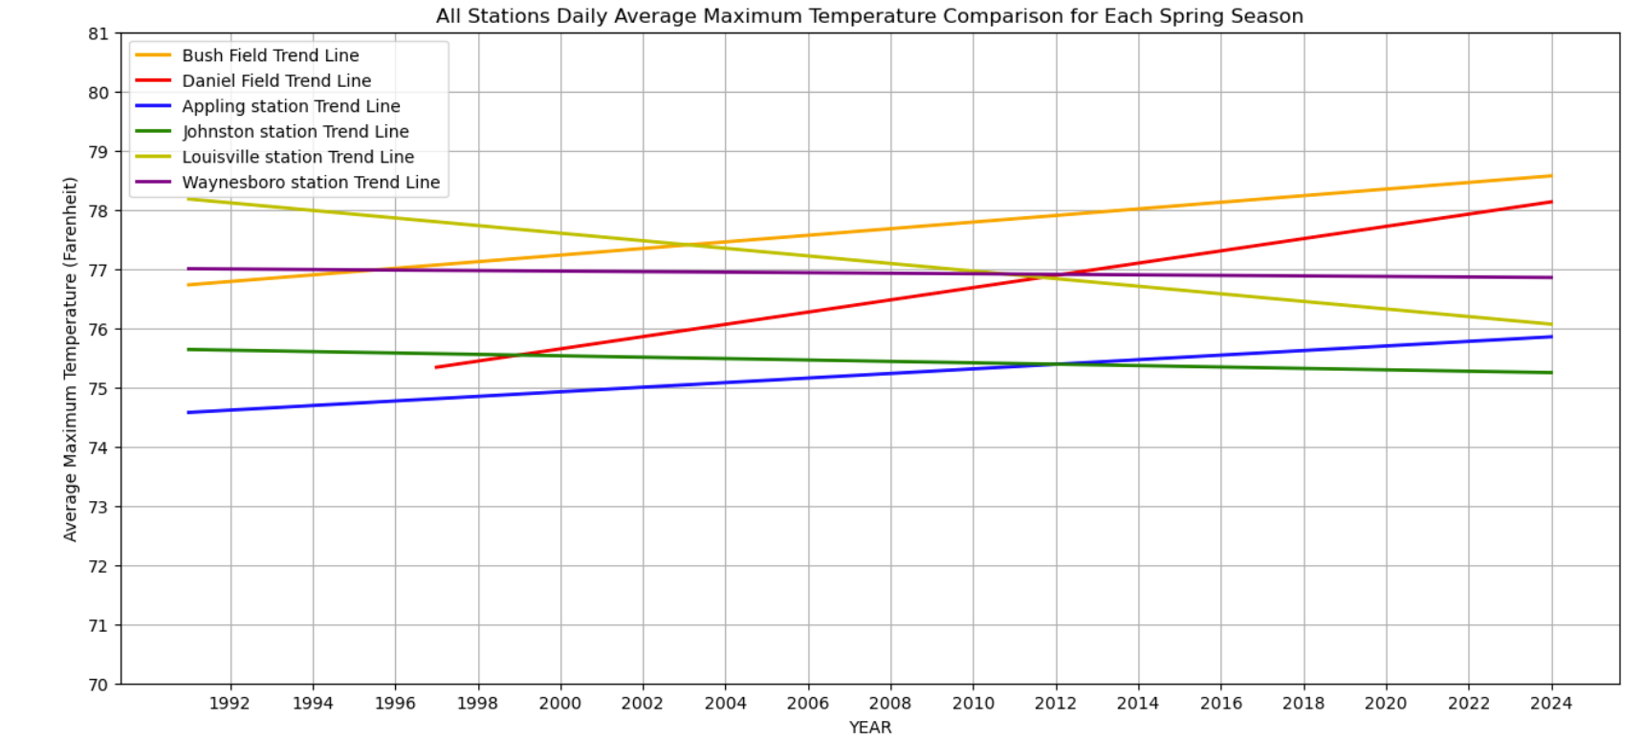

Slide 4
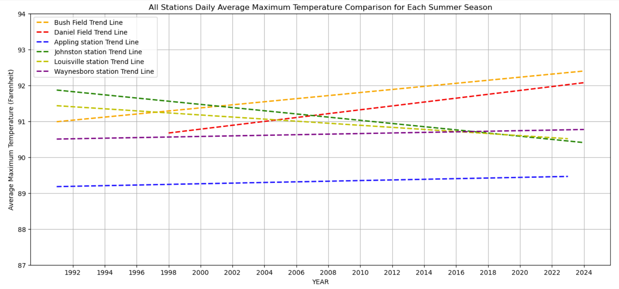


Slide 5

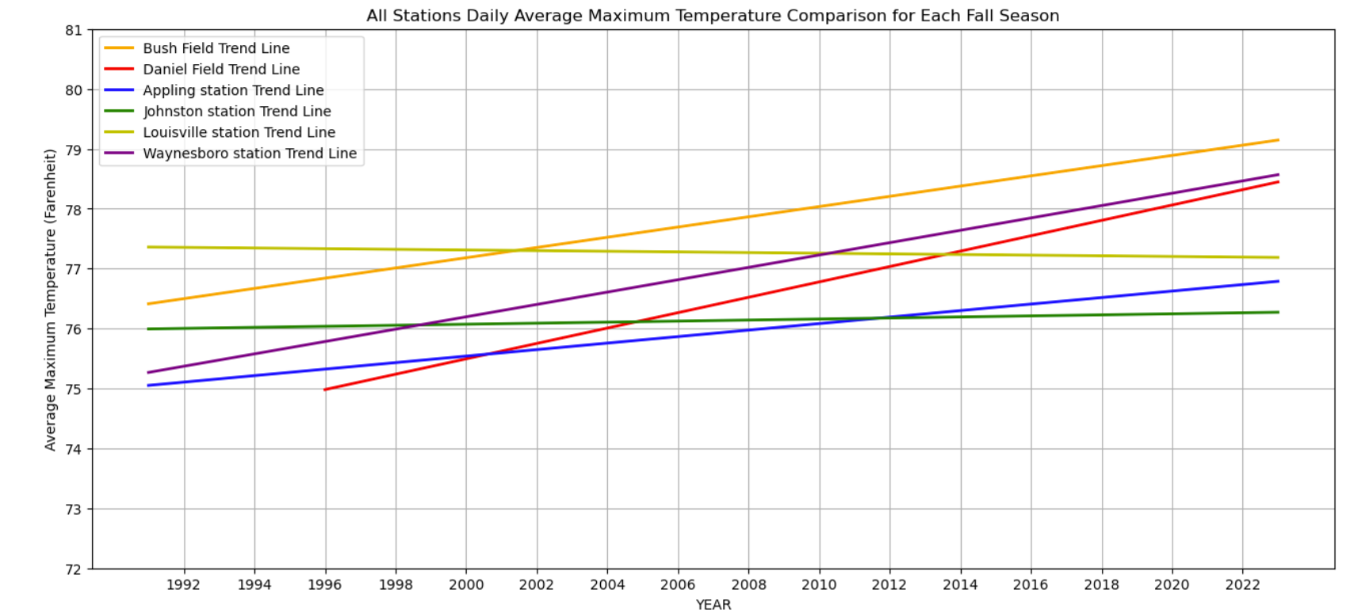

Slide 6
ALL STATIONS SEASONAL AVG MIN TEMP ANALYSIS
Observations from 6 Stations

Slide 7
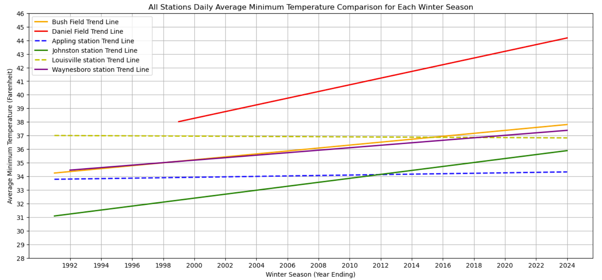


Slide 8

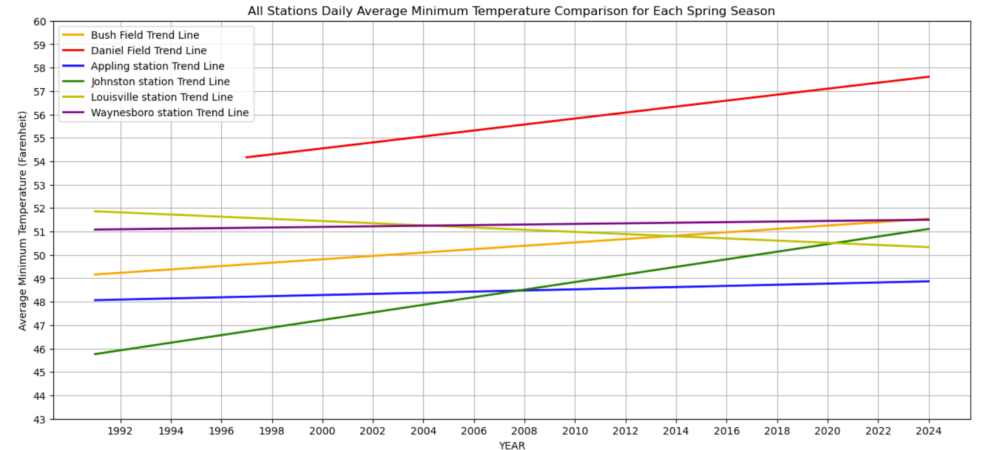

Slide 9
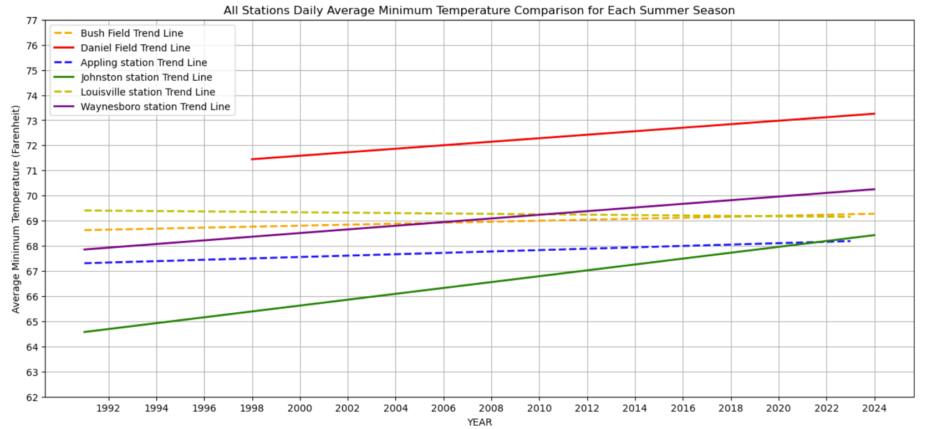


Slide 10

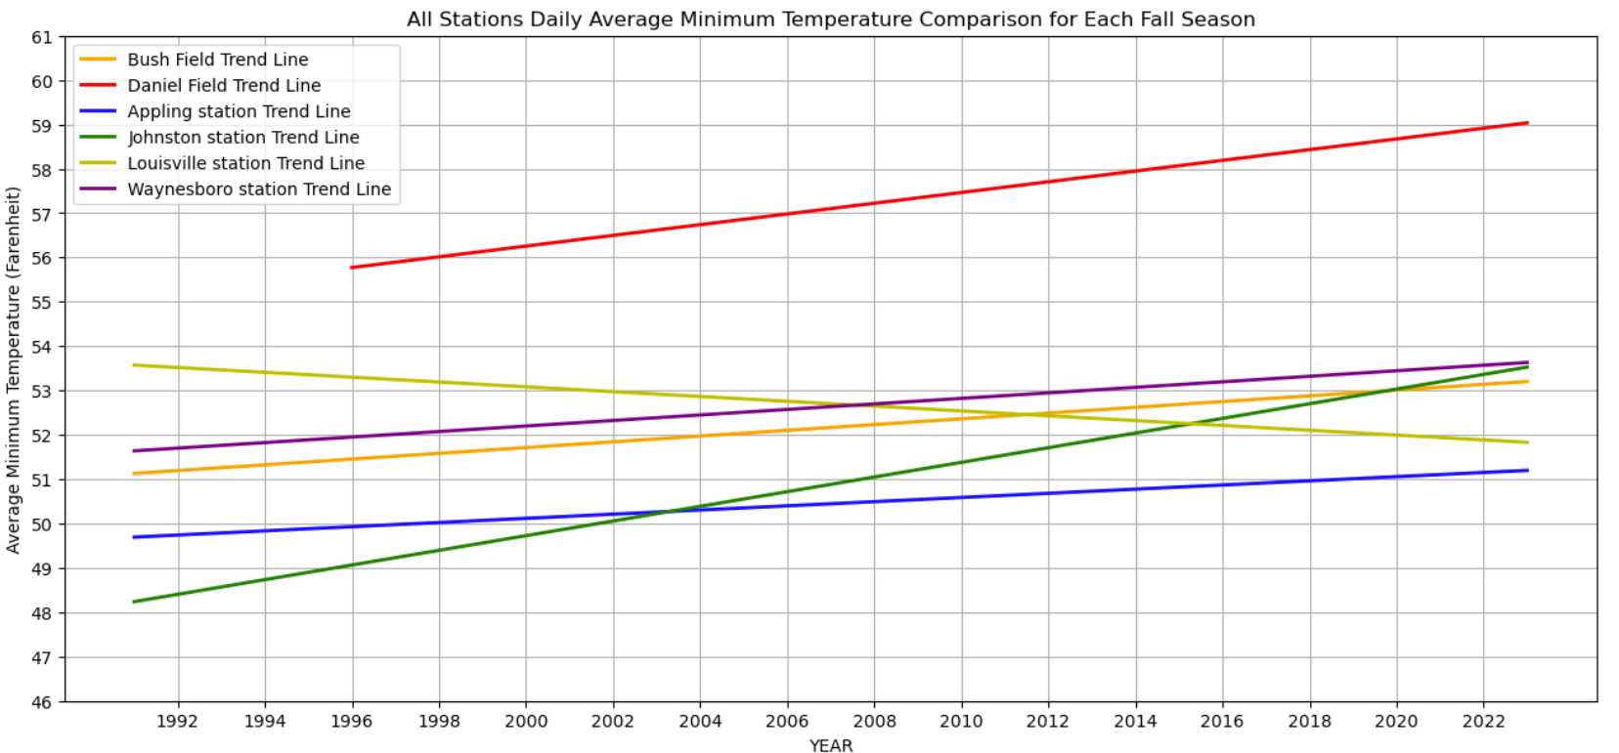

Slide 11
ALL STATIONS SEASONAL PRECIPITATION ANALYSIS
Observations from 6 Stations

Slide 12
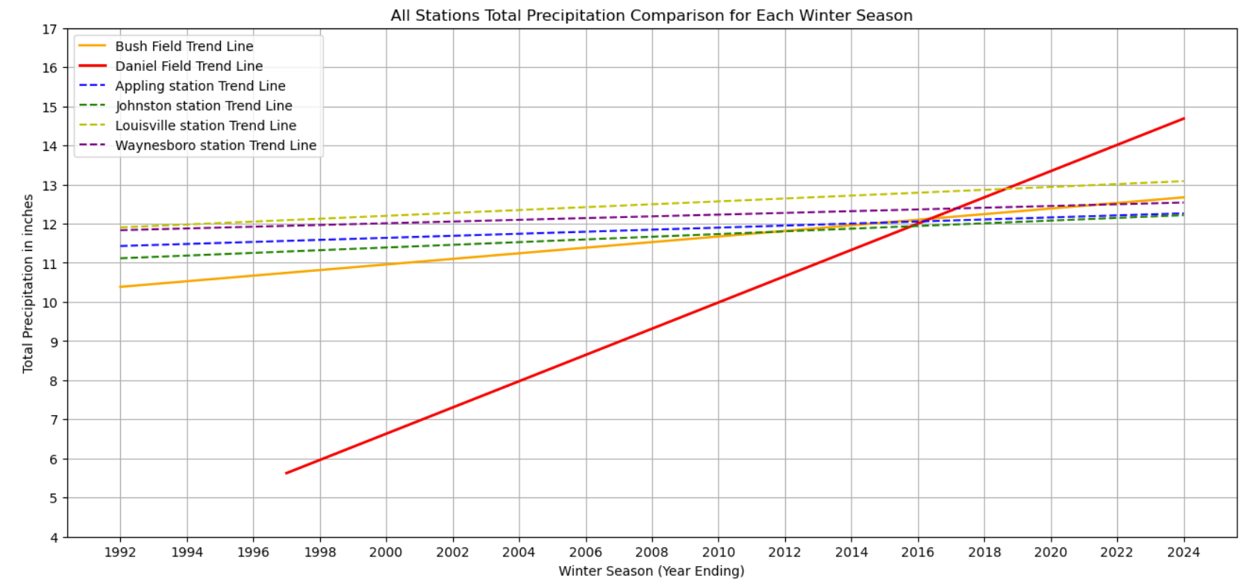


Slide 13
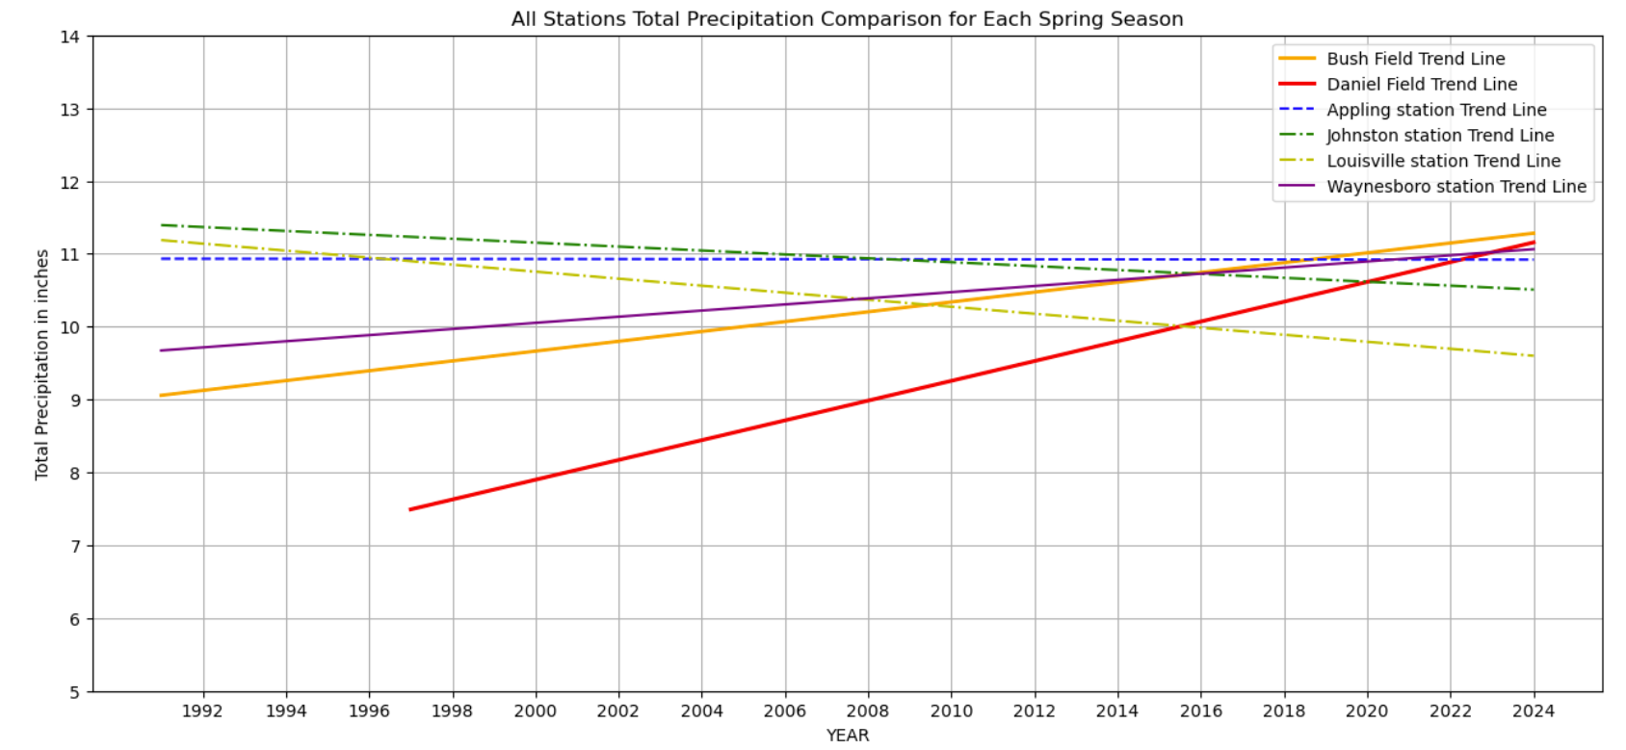


Slide 14

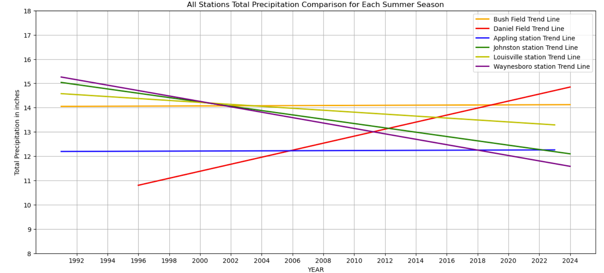

Slide 15

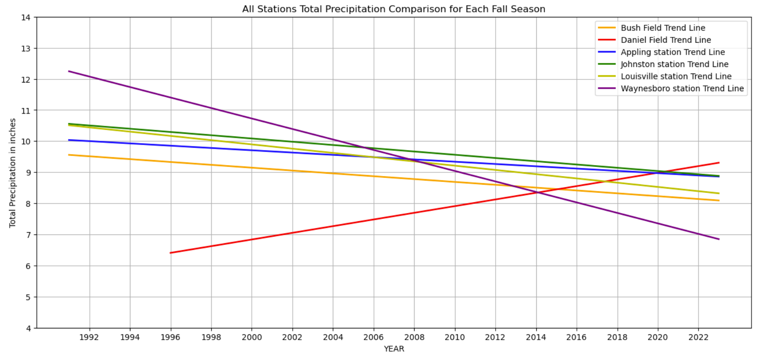

Slide 16
NUMBER OF DAYS OVER 95 F FOR EACH YEAR SINCE 1991 ANALYSIS
Observations from 6 Stations

Slide 17

